Slide 1
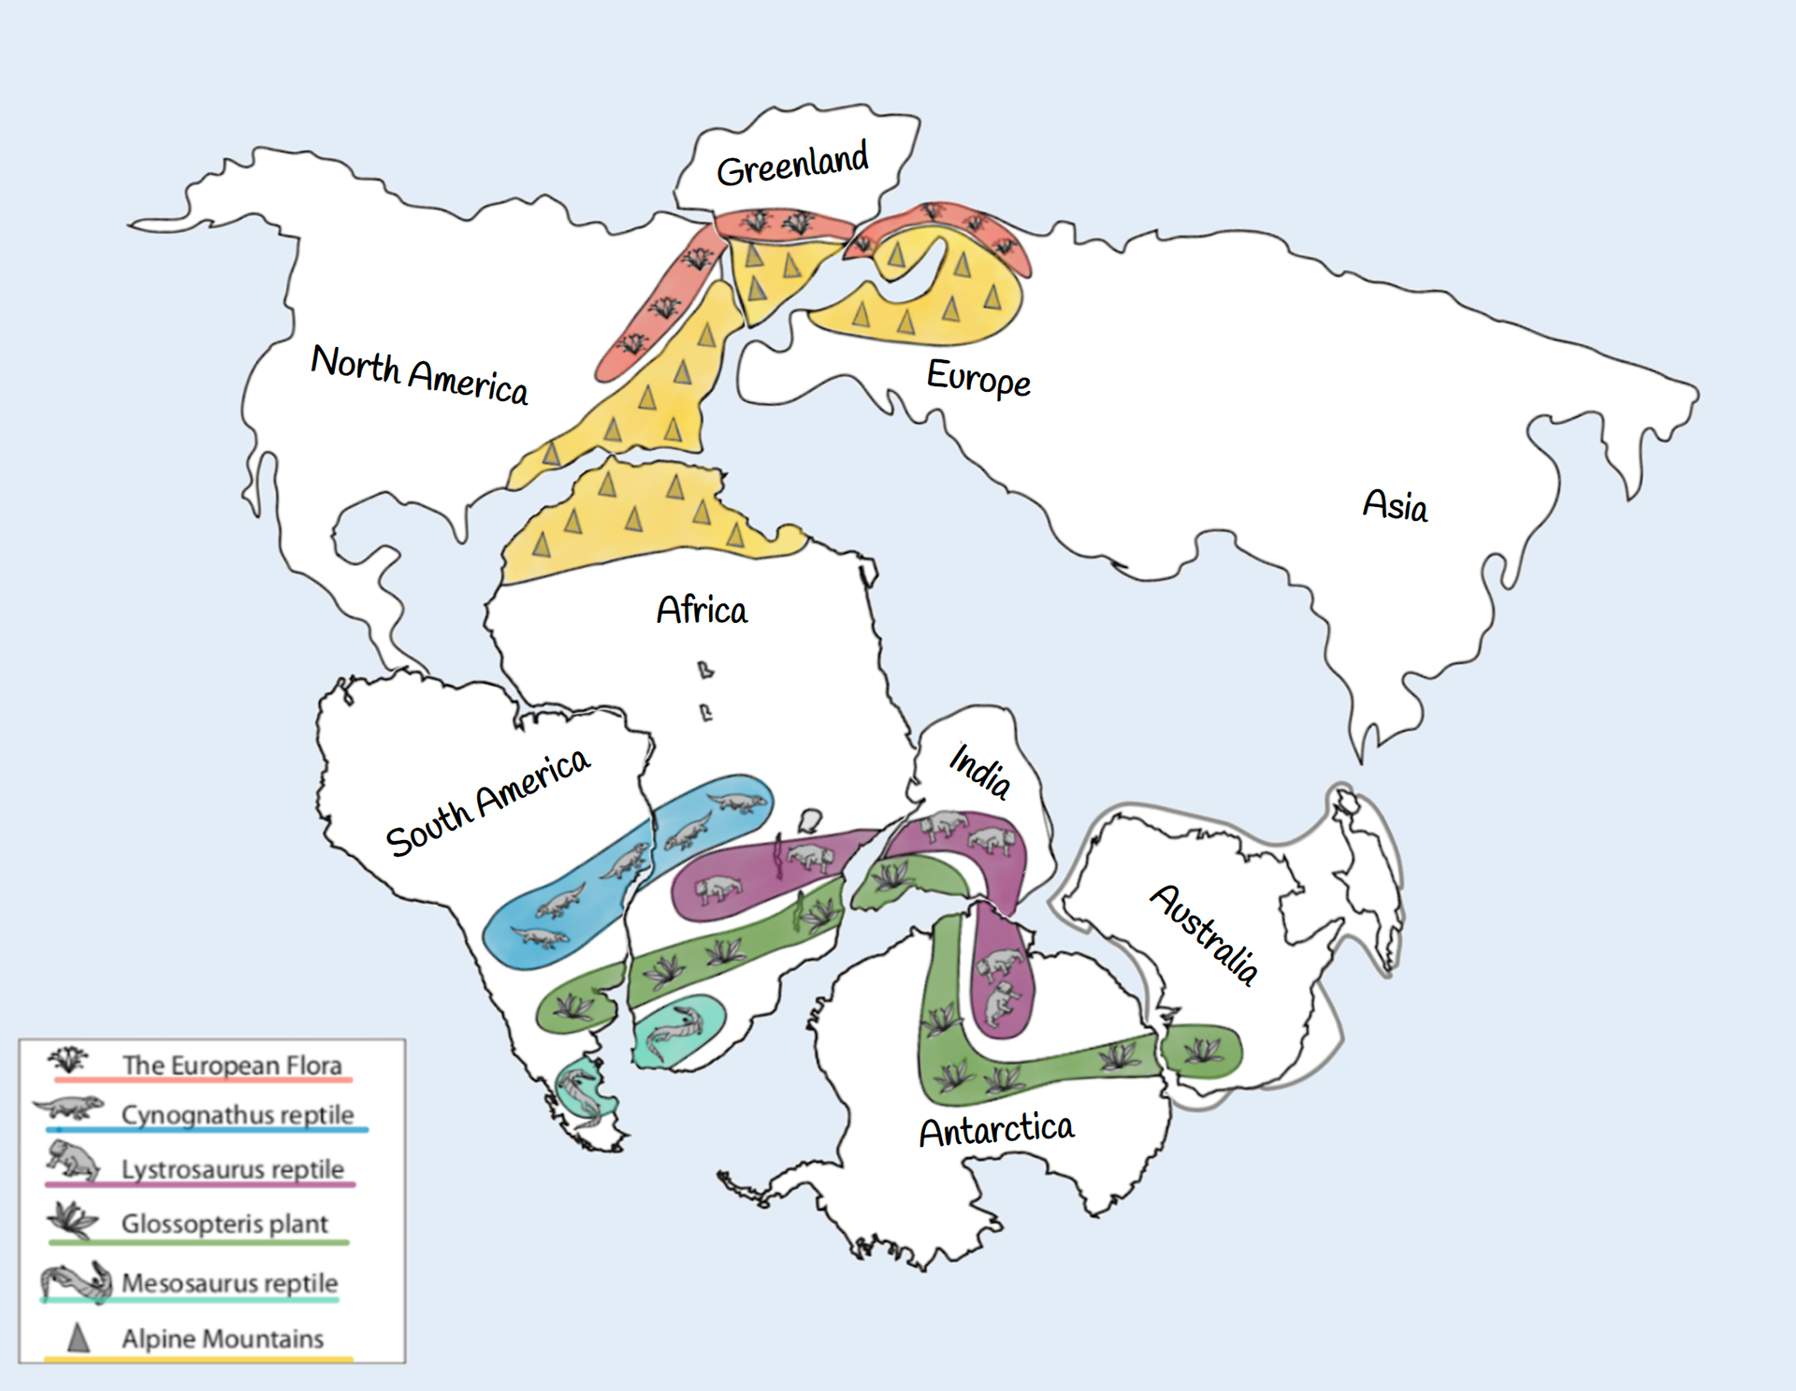
Reconstructing Points
Practical GPlates
Elizabeth M. Dowding
dowdingem@gmail.com
May 2025

Slide 2
Contents
Introduction to learning outcomes
Reference Frames
Single Points in GPlates
Shape Files and multiple points
Assignment groups

Slide 3
Introduction to learning outcomes
Session 1
Introduction to theory
Session 2
Introduction to using GPlates
Practical guide to picking a plate reconstruction
Session 3
Mantle Reference Frame
Using a plate reconstruction
Assignment
Group task
https://adamtkocsis.com/se3-gplates/

Slide 4
Assignment
Practical exercise with GPlates
Short report (max. 3 A4 pages)
Assignment can be written in German
Due until the end of the lecture period (July) - necessary to pass the course
The Assignment | GPlates for System Erde III. (adamtkocsis.com)

Slide 5
Revision
Plate tectonics is the theory that underpins plate reconstructions
Palaeomagentic data helps us to create euler poles and our plate rotations
A collection of euler poles leads to the development of Apparent Polar wander
There are many plate models and some are better for some purposes than others

Slide 6
Mantle RF and Palaeomag RF

Slide 7
Apparent Polar Wander? True Polar Wander?

Slide 8
Apparent Polar Wander? True Polar Wander?

Slide 9
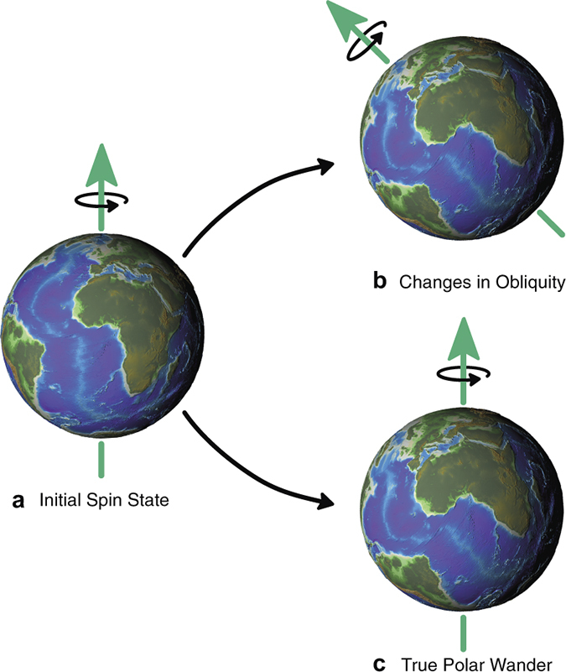
Apparent Polar Wander? True Polar Wander?

Slide 10
Earth is a spinning ball in space
Notes:
APW is earth relative.
TPW corrected for earths situation in the cosmos

Slide 11
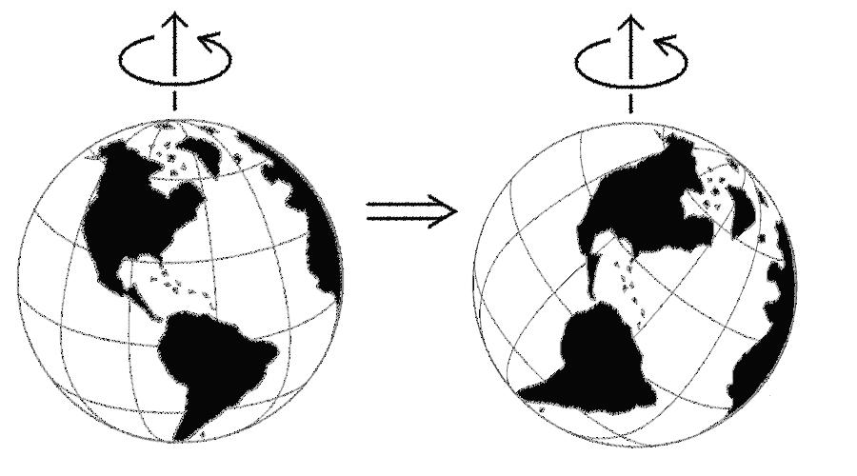
True Polar Wander: consider reconstruction
Notes:
The arrangement is the same. The latitudes are very different.

Slide 12
True Polar Wander
TPW results from changes in the magnetic pole position caused by global slip at the core-mantle boundary, at least in part in response to changes in mass redistribution at the surface caused by the formation and breakup of supercontinents. Movement of the entire lithosphere with respect to the mantle or of the mantle relative to the core can produce the same effect.
Notes:
Comparison of plate motions assuming a fixed hotspot framework indicates that TPW has amounted to about 12° since the Early Tertiary. Because TPW affects equally all calculated poles of a given age in the same way, however, it does not usually influence relative plate motions deduced from APW paths.

Slide 13
True Polar Wander
Formal definition:
As defined as the migration of the maximum moment of inertia (I_{max}) to. align with Earth’s spin axis, TPW occurs as a rotation about an Euler pole controlled by the minimum moment of inertia (I_{min}) that is equatorial and is therefore predicted to circumscribe a great-circle APW path
Notes:
Comparison of plate motions assuming a fixed hotspot framework indicates that TPW has amounted to about 12° since the Early Tertiary. Because TPW affects equally all calculated poles of a given age in the same way, however, it does not usually influence relative plate motions deduced from APW paths.

Slide 14
In GAD we trust

Slide 15
Q: Does TPW influence APW?

Slide 16
Q: Does TPW influence APW?
Q. What happens if we don’t account for TPW in our APW?

Slide 17
Q. Does TPW influence APW?
Q. What happens if we don’t account for TPW in our APW?
Q. What happens to our tectonic reconstructions?

Slide 18
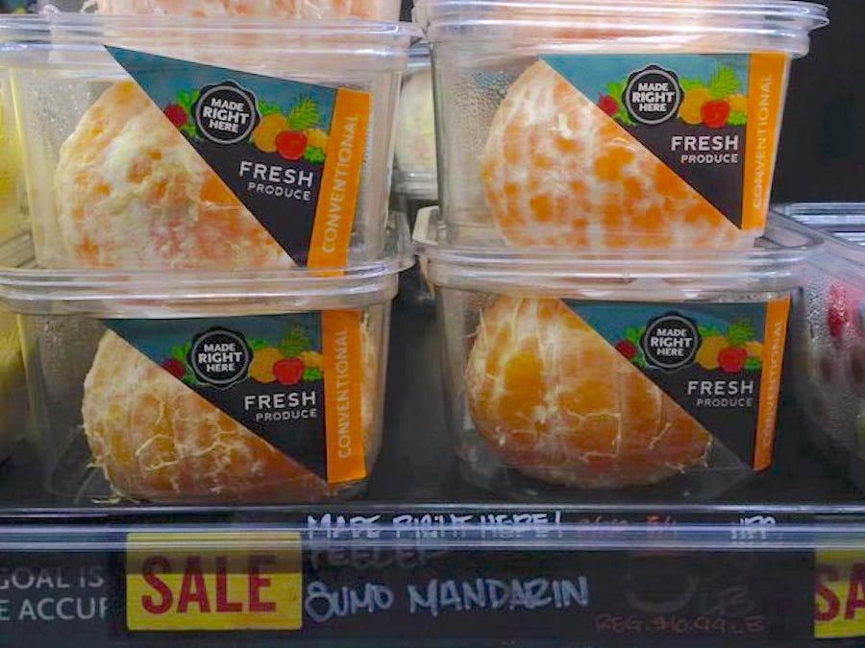
Mantle Reference Frame

Slide 19
https://youtu.be/swGDLBOCqBg
Notes:
https://youtu.be/swGDLBOCqBg

Slide 20
Earth’s mantle heterogeneity theories
Notes:
Creator: Anna Gülcher
This version: 17.12.2022
License: Attribution-ShareAlike 4.0 International (CC BY-NC-SA 4.0)
Specific citation: These graphics by Anna Gülcher from Gülcher et al. (2021) are available via the open-access s-Ink.org repository.
Related reference: Gülcher, A. J. P., Ballmer, M. D., and Tackley, P. J. (2021), Coupled dynamics and evolution of primordial and recycled heterogeneity in Earth’s lower mantle, Solid Earth, 12, 2087–2107, 2021 https://doi.org/10.5194/se-12-2087-2021

Slide 21
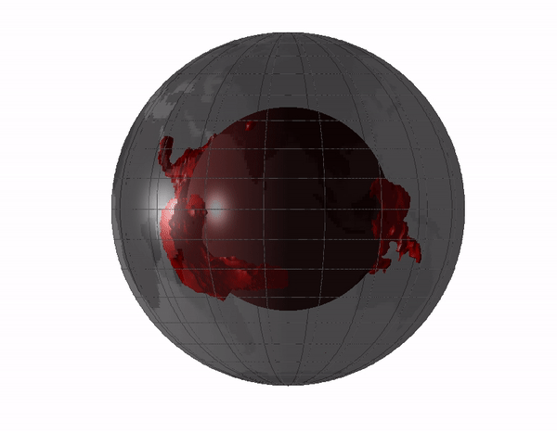
Large Low-Shear-Velocity Province
3% slower than the rest of the mantle
Thermochemical piles: near antipodal and equatorial.
Their edges are ‘plume generation zones’ and can impact the Wilson cycle.
LLSVPs are thermal insulator, making core heating effective at their edges for mantle plumes.
Notes:
Origin of the LLSVPs at the base of the mantle is a consequence of plate tectonics – A petrological and geochemical perspective - ScienceDirect

Slide 22
Seismic mantle tomography maps
Notes:
Surface projected global horizontal seismic S-wave velocity anomaly maps for different mantle depths revealing the two large low shear-wave velocity provinces (LLSVPs) below the Pacific (named Jason) and Africa (named Tuzo). Shown is the S10MEAN model based on Doubrovine et al. (2016) averaging 10 tomography models allowing to compare relative variations in S-wave velocity. The Scientific colour map ‘batlow‘ is used to represent data accurately and to all readers.
Creator: Fabio Crameri
This version: 31.10.2021
License: Attribution-ShareAlike 4.0 International (CC BY-SA 4.0)
Specific citation: This graphic by Fabio Crameri based on data compiled by Doubrovine et al. (2016) is available via the open-access s-Ink repository.
Related references: Doubrovine, P. V., Steinberger, B., and Torsvik, T. H. (2016), A failure to reject: Testing the correlation between large igneous provinces and deep mantle structures with EDF statistics, Geochem. Geophys. Geosyst., 17, 1130– 1163, doi:10.1002/2015GC006044.

Slide 23
Seismic mantle tomography maps
Jason
Jason
Tuzo
Notes:
Surface projected global horizontal seismic S-wave velocity anomaly maps for different mantle depths revealing the two large low shear-wave velocity provinces (LLSVPs) below the Pacific (named Jason) and Africa (named Tuzo). Shown is the S10MEAN model based on Doubrovine et al. (2016) averaging 10 tomography models allowing to compare relative variations in S-wave velocity. The Scientific colour map ‘batlow‘ is used to represent data accurately and to all readers.
Creator: Fabio Crameri
This version: 31.10.2021
License: Attribution-ShareAlike 4.0 International (CC BY-SA 4.0)
Specific citation: This graphic by Fabio Crameri based on data compiled by Doubrovine et al. (2016) is available via the open-access s-Ink repository.
Related references: Doubrovine, P. V., Steinberger, B., and Torsvik, T. H. (2016), A failure to reject: Testing the correlation between large igneous provinces and deep mantle structures with EDF statistics, Geochem. Geophys. Geosyst., 17, 1130– 1163, doi:10.1002/2015GC006044.

Slide 24
Where, what, and why?
(1) subduction of the ocean crust of basaltic composition (SOC)to the lower mantle is irreversible because SOC is denser than the ambience of peridotitic composition under lower mantle conditions in both solid state and liquid form

Slide 25
Where, what, and why?
subduction of the ocean crust of basaltic composition (SOC)to the lower mantle is irreversible because SOC is denser than the ambience of peridotitic composition under lower mantle conditions in both solid state and liquid form;
SOC is the best candidate for the LLSVPs composition, which are, in turn, the permanent graveyard of SOC.

Slide 26
Where, what, and why?
subduction of the ocean crust of basaltic composition (SOC)to the lower mantle is irreversible because SOC is denser than the ambience of peridotitic composition under lower mantle conditions in both solid state and liquid form;
SOC is the best candidate for the LLSVPs composition, which are, in turn, the permanent graveyard of SOC.
the LLSVPs act as thermal insulators, making core-heating induced mantle diapirs or plumes initiated at their edges, which explains why the large igneous provinces (LIPs) are associated with the edges of the LLSVPs

Slide 27
Where, what, and why?
subduction of the ocean crust of basaltic composition (SOC)to the lower mantle is irreversible because SOC is denser than the ambience of peridotitic composition under lower mantle conditions in both solid state and liquid form;
SOC is the best candidate for the LLSVPs composition, which are, in turn, the permanent graveyard of SOC.
the LLSVPs act as thermal insulators, making core-heating induced mantle diapirs or plumes initiated at their edges, which explains why the large igneous provinces (LIPs) are associated with the edges of the LLSVPs
The antipodal positioning of Jason and Tuzo represents the optimal momentum of inertia, which explains why the LLSVPs are stable in the spinning Earth.

Slide 28
Where, what, and why?
subduction of the ocean crust of basaltic composition (SOC)to the lower mantle is irreversible because SOC is denser than the ambience of peridotitic composition under lower mantle conditions in both solid state and liquid form;
SOC is the best candidate for the LLSVPs composition, which are, in turn, the permanent graveyard of SOC.
the LLSVPs act as thermal insulators, making core-heating induced mantle diapirs or plumes initiated at their edges, which explains why the large igneous provinces (LIPs) are associated with the edges of the LLSVPs
The antipodal positioning of Jason and Tuzo represents the optimal momentum of inertia, which explains why the LLSVPs are stable in the spinning Earth.
EXTREMELY CONTENTIOUS
Notes:
Origin of the LLSVPs at the base of the mantle is a consequence of plate tectonics – A petrological and geochemical perspective - ScienceDirect

Slide 29
The way you think about a problem will ALWAYS impact the product.

Slide 30
The PMRF has problems
The MRF has problems
Notes:
Mantle reference frames use mantle features such as upwellings and subducted slabs as an absolute reference to plate motion. These reference frames do not always reflect the true position of past continents as they neglect true polar wander. This is shown in the figure with the implied spin axis of the Earth in a mantle frame actually in a different place in the paleomagnetic frame due to a shifting of the plate-mantle system relative to the core. Image by Rachel O’Brien and based on Conrad et al, 2013.

Slide 31
True Polar Wander: a reminder
https://youtu.be/UEEFlmxVh94
Notes:
https://youtu.be/UEEFlmxVh94
Break. ☺

Slide 32
For Windows
C:\Program Files\Gplates\GPlates2.5.0\GeoData\
For Macs
GPlates installed into applications

Slide 33
2 | Tool Palette | A collection of tools which are used to interact with the globe and geological features via the mouse pointer.
https://www.gplates.org/docs/user-manual/Introducing_The_Main_Window/
Notes:
Gplates : https://www.gplates.org/docs/user-manual/Introducing_The_Main_Window/

Slide 34
2 | Tool Palette | A collection of tools which are used to interact with the globe and geological features via the mouse pointer.
Drag Globe
~Will deselect Feature
https://www.gplates.org/docs/user-manual/Introducing_The_Main_Window/
Notes:
Gplates : https://www.gplates.org/docs/user-manual/Introducing_The_Main_Window/

Slide 35
2 | Tool Palette | A collection of tools which are used to interact with the globe and geological features via the mouse pointer.
Drag Globe
~Will deselect Feature
Choose Feature
~ Used for selecting
If selected will appear in 10
https://www.gplates.org/docs/user-manual/Introducing_The_Main_Window/
Notes:
Gplates : https://www.gplates.org/docs/user-manual/Introducing_The_Main_Window/

Slide 36
2 | Tool Palette | A collection of tools which are used to interact with the globe and geological features via the mouse pointer.
Drag Globe
~Will deselect Feature
Choose Feature
~ Used for selecting
If selected will appear in 10
Digitise Multi-point Geometry
~Used for creating new features
https://www.gplates.org/docs/user-manual/Introducing_The_Main_Window/
Notes:
Gplates : https://www.gplates.org/docs/user-manual/Introducing_The_Main_Window/

Slide 37
Tutorial Links
Single point reconstructions | GPlates for System Erde III. (adamtkocsis.com)
https://adamtkocsis.com/se3-gplates/singlepoint/

Slide 38
EXTENSION Tutorial Links
https://adamtkocsis.com/se3-gplates/multipoint/
Reconstructing actual data | GPlates for System Erde III. (adamtkocsis.com)

Slide 39
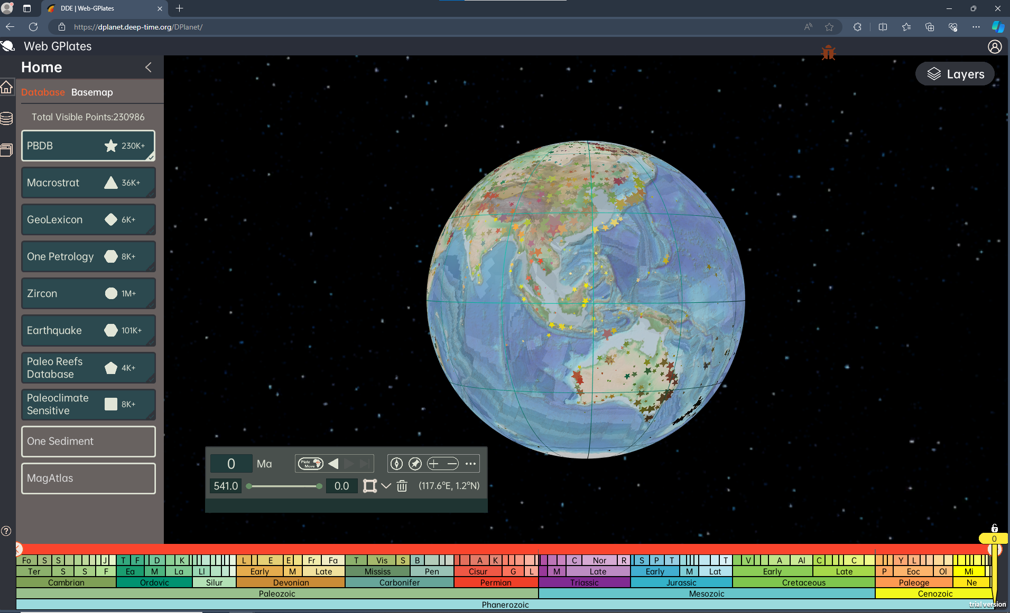
DDE | Web-GPlates (deep-time.org)
https://dplanet.deep-time.org/DPlanet/

